Slide 1
Practice Therapeutics Orals

Slide 2
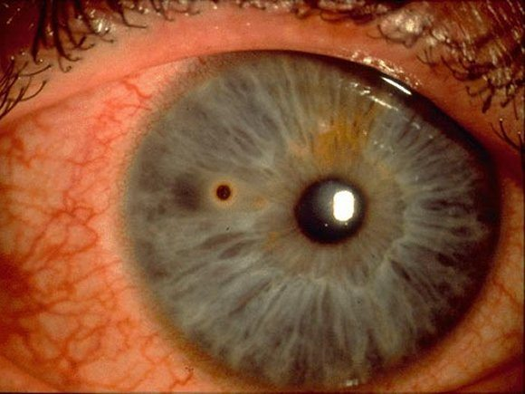
25YOM presents with photophobia, mild pain and lacrimation following “something flying in his right eye” after working on his car yesterday.
Describe what you see
What other questions would you ask?
What other tests would you do?
What is your management?
What is the prognosis?
In what situations would you refer?
Notes:
https://lifeinthefastlane.com/ophthalmology-befuddler-010/
Early in the day he was cleaning up the workshop and felt something get in his right eye, he then rinsed his eye out with water. Over the course of the day the irritation worsened, his eye is constantly watering and its becoming red.
The foreign body is at about 9 o’clock o the surface of the cornea, midway across the iris. A rust ring and conjunctival injection is present
How long does it take for rust ring to form? 4 – 6 hours (fluid from cornea begins to decompose and rush leaches into surrounding tissue)
What other tests? Seidel sign, DFE
What tools? Q tip, 25G needle, metallic spud, algar brush
Provide topical anesthesia
Remove foreign body using a slit lamp
use fluorescein to assess the depth and measure the size of the epithelial defect
give oral analgesia and a cycloplegic agent (e.g. 2% homatropine) for comfort??
give topical antibiotics
arrange appropriate follow up
Role of bandage contact lens? In select cases it is appropriate (i.e. more severe) However if px has had no CL experience, I would avoid just in case it dislodges or taco rolls. It may also contribute to more infective climate so monitor closely. REMOVE 24 HRS
What other aspects need to be consolidated at follow-up? Safety specs,
What is the prognosis? Any difference if patient diabetic? Expect full epithelial recovery in 1 week (stop prophylactic ab 3 days after re-epithlialisation) – Expect longer if diabetic
When will it scar? What would you do? If penetrated into stroma – so consider steroids i.e. pred forte 1% QID for 7-10days.
There is no evidence that eye patches are helpful. They may even be harmful due to loss of binocular vision. A meta-analysis has shown that for small corneal abrasions there is no benefit from patching the eye. [Turner A, Rabiu M. Patching for corneal abrasion. Cochrane Database Syst Rev. 2006 Apr 19;(2):CD004764. PMID: ]
If the foreign body — or an associated rust ring — is not completely removed follow up should be arranged within 24 hours.
Opthalmology review is required if there is a persistent epithelial defect (>3 days)
Ocular penetration

Slide 3
25YOM presents with photophobia, mild pain and lacrimation following “something flying in his right eye” after working on his car yesterday.
Describe what you see A corneal metallic foreign body 0.5mm in size with associated rust ring in temporal midperipheral cornea (4mm away from visual axis) + conjunctival injection. No iris tears
What other questions would you ask? What type of foreign body? Velocity of impact? Symptoms? Eye protection?
What other tests would you do? Evert eyelids (look for other FBs), Seidel sign (penetrating), IOP, DFE (if penetrating)
What is your management? Remove FB (px consent, anaesthesia, depending on depth – flush w/ saline, q-tip, 25G needle, metallic spud, algar brush for removing rust ring). Prophylactic antibiotic (chlorsig 0.5% eyedrops QID), in-office tropicamide for photophobia, refresh P/F lubricants QID. Review 24hrs. Then depending on clinician experience, day 3 and day 7 until re-epithelialisation
What is the prognosis? Good – away from visual axis
In what situations would you refer? Ocular penetration, if persistent epithelial defect (> 3 days)
Notes:
https://lifeinthefastlane.com/ophthalmology-befuddler-010/
Early in the day he was cleaning up the workshop and felt something get in his right eye, he then rinsed his eye out with water. Over the course of the day the irritation worsened, his eye is constantly watering and its becoming red.
The foreign body is at about 9 o’clock o the surface of the cornea, midway across the iris. A rust ring and conjunctival injection is present
How long does it take for rust ring to form? 4 – 6 hours (fluid from cornea begins to decompose and rush leaches into surrounding tissue)
What other tests? Seidel sign, DFE
What tools? Q tip, 25G needle, metallic spud, algar brush
Provide topical anesthesia
Remove foreign body using a slit lamp
use fluorescein to assess the depth and measure the size of the epithelial defect
give oral analgesia and a cycloplegic agent (e.g. 2% homatropine) for comfort??
give topical antibiotics
arrange appropriate follow up
Role of bandage contact lens? In select cases it is appropriate (i.e. more severe) However if px has had no CL experience, I would avoid just in case it dislodges or taco rolls. It may also contribute to more infective climate so monitor closely. REMOVE 24 HRS
What other aspects need to be consolidated at follow-up? Safety specs,
What is the prognosis? Any difference if patient diabetic? Expect full epithelial recovery in 1 week (stop prophylactic ab 3 days after re-epithlialisation) – Expect longer if diabetic
When will it scar? What would you do? If penetrated into stroma – so consider steroids i.e. pred forte 1% QID for 7-10days.
There is no evidence that eye patches are helpful. They may even be harmful due to loss of binocular vision. A meta-analysis has shown that for small corneal abrasions there is no benefit from patching the eye. [Turner A, Rabiu M. Patching for corneal abrasion. Cochrane Database Syst Rev. 2006 Apr 19;(2):CD004764. PMID: ]
If the foreign body — or an associated rust ring — is not completely removed follow up should be arranged within 24 hours.
Opthalmology review is required if there is a persistent epithelial defect (>3 days)
Ocular penetration

Slide 4
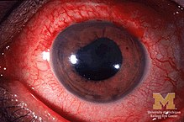
22YOM presents with 1 day history of red and painful LE. Vision is blurry and he is sensitive to lights. He has not had this before.
Describe what you see?
What other tests would you do?
What are your ddx? And most likely dx?
What is the pathophysiology of AAU?
If you saw approx. 25-30cells in 1mm x 1mm field in AC, what is your mx?
Are there any side effects of your tx?
What are the proposed mechanisms of steroid induced IOP? What are the classifications and who is most at risk?
Notes:
Grade 2-3 Cells and flare = 16-25 vs 26-50 cells in 1mm x 1mm field
Let’s say they have ~ 25cells what is mx?
What is Grade 2-3 flare?
0 = none, 1 = faint, 2 = moderate (iris and lens still clear). 3 = marked (iris and lens hazy), 4 = intense (fibrin or plastic aqueous)
What do you expect the IOP to be compared to other normal eye? Generally slightly less as CB inflamed so can’t produce as much and increase in released prostaglandins = increased uveoscleral outflow in acute phase but occasionally greater due to reduced outflow (trabeculitis, inflammatory cells or debris blocking angle, ant/post synechiae, trabeculosclerosis or steroid response)
Elevated IOP more common in infectious uveitis (herpes/toxoplasmosis), Fuch’s heterochromic iridocyclitis, Posner-Schlossman syndrome, juvenile chronic arthritis associated uveitis and sarcoidosis [Panek WC, Holland GN, Lee DA, Christensen RE. Glaucoma in patients with uveitis. Br J Ophthalmol1990; 74: 223–227. Moorthy RS, Mermoud A, Baerveldt G, Minckler DS, Lee PP, Rao NA. Glaucoma associated with uveitis. Surv Ophthalmol 1997; 41: 361–394.]
http://onlinelibrary.wiley.com/doi/10.1111/j.1444-0938.2006.00128.x/full
Review of systems
• Rheumatological: spondyloarthropathies, especially ankylosing spondylitis
• Genito-urinary: Reiter’s syndrome, Behçet’s disease, syphilis
• Respiratory: sarcoidosis, tuberculosis
• Gastrointestinal: inflammatory bowel disease
• Dermatological: psoriasis, syphilis, sarcoidosis, herpes simplex, herpes zoster, Behçet’s disease.
Pathophysiology of AAU?
- Breakdown of blood aqueous barrier i.e. increased permeability of iris/ciliary body capiliaries → escape of leukocytes, protein and fibrin into aqueous
Steroids:
Mild/Moderate – predforte 1% every 2 hours
Severe – predforte 1% every hour
Consider loading dose i.e. 1 drop every 15mins for 1st hour OR 1 drop every 30mins for 1st 2 hours (Nussenblatt RB, Whitcup SM. Uveitis; Fundamentals and Clinical Practice, 3rded. Philadelphia: Mosby, 2004)
What is the mechanism of action of steroid?
Steroids inhibit phospholipases which convert cell membrane phospholipids to arachidonic acid
Why pred forte?
Acetate form penetrates intact corneal epithelium and prednisolone acetate has greatest antiinflamamtory effect [Leibowitz HM. Management of inflammation in the cornea and conjunctiva. Ophthalmology 1980; 87: 753–758.]
Does dosage include night time hours? In severe cases yes, otherwise an alternative is to double dose during waking hours
What are some ocular side effects of steroids?
IOP response – elevation
Posterior subcapsular cataract
Increased susceptibility to infection
Corneal thinning
What other options of therapy are there and would you consider these?
NSAIDs have theoretical advantages which act on the cyclooxygenase pathway (COX). However, generally believed that NSAIDs have inadequate anti-inflammatory effect in AAU but could be considered if contraindications to topical steroids. Study comparing dexamethasone and indomethacin used 6x/day for AAU showed significantly less inflammation in steroid group after 7 days of tx [
Sand BB, Krogh E. Topical indomethacin, a prostaglandin inhibitor, in acute anterior uveitis. A controlled clinical trial of non-steroidal versus steroid anti-inflammatory treatment. Acta Ophthalmol 1991; 6: 145–148.]
Cycloplegics
Homatropine 2%, 3x a day OR atropine 1% 3x a day
What about cyclopentolate?- Cyclopentolate may act as a chemo-attractant for leukocytes and should be avoided in the presence of inflammation (Nussenblatt RB, Whitcup SM. Uveitis; Fundamentals and Clinical Practice, 3rded. Philadelphia: Mosby, 2004)
What about tropicamide? - In patients with mild inflammation and no synechiae at initial presentation, some clinicians argue that tropicamide can be effective by permitting enough iris movement to prevent the formation of new synechiae (Nussenblatt RB, Whitcup SM. Uveitis; Fundamentals and Clinical Practice, 3rded. Philadelphia: Mosby, 2004)
Posterior synechiae
If persistent
2% homatropine > 1% atropine > 2.5% phenylephrine > 10% phenylephrine > pledget
REM: Shake bottle (suspension) and allow sufficient time between diff drops, review 24hrs and then depending on clinician experience either daily or every 2-3 days until 2 step improvement in severity (i.e. G2 – G0 or G3 – G1 cells) then begin taper of steroids (SUN)
Why do we need to taper?
To prevent rebound inflammation
What is typical tapering schedule like?
Most cases will require about 6 – 8 weeks of treatment (taper to 0 by this time). i.e. Week 1 q1h, Week 2 q2h, Week 3 qid, Week 4 tid Week 5 bid Week 6 qd
If steroid response?
Therapy should target aqueous production because aqueous outflow is likely to be compromised. Topical beta antagonists are the first choice [Moorthy RS, Mermoud A, Baerveldt G, Minckler DS, Lee PP, Rao NA. Glaucoma associated with uveitis. Surv Ophthalmol 1997; 41: 361–394.]
What are some common blood tests used to help localise etiology of uveitis?
CBC (complete blood count) = general health status and identifying anaemia, infection and leukaemia
HLA-B27 (human leukocyte antigen B27) = found on surface of WBCs in autoimmune disorders e.g. ankylosing spondylitis, Reiter syndrome
CRP (c-reactive protein) = marker for inflammation and serves as tx response monitor (good for acute phase) but unable to determine location of inflammation
ESR (erythrocyte sedimentation rate) = Same as above but better for chronic?
ANA (antinuclear antibody) = autoimmune disorders e.g. systemic lupus erythematosus, scleroderma, juvenile arthritis, polymyositis, inflammatory bowel disease and psoriasis
RF (rheumatoid factor) = rheumatoid arthritis and Sjogren’s and others that overlap with ANA
RPR (rapid plasma regain), VDRL (venereal disease research laboratory) FTA-ABS (fluorescent treponemal antibody absorption test = syphilis – treponema pallidum is bacteria in syphilis
ACE (angiotensin converting enzyme) = sarcoidosis
Chest X-Ray = tuberculosis or sarcoidosis
PPD (purified protein derivative) = tuberculosis
ELISA (lyme titre and enzyme-linked immunosorbent assay) = Lyme disease and HIV
When would you consider a referral to ophthalmologist?
Hypopyon
Bilateral
Intermediate/posterior/pan-uveitis
Recent surgery or presence of drainage bleb
Presence of severe or atypical inflammation

Slide 5
22YOM presents with 1 day history of red and painful LE. Vision is blurry and he is sensitive to lights. He has not had this before.
Describe what you see? Conj injection w/ 360 circumciliary flush (sup especially), dyscoria (likely from post synechiae),
What other tests would you do in the consulting room? Assess AC, NaFl assessment, IOP, DFE
What are your ddx? And most likely dx? AAU, FHI, PSS, traumatic iritis, drug-induced uveitis (rifabutin, cidofovir), sclerouveitis, CLARE, infectious keratouveitis (herpes/toxoplasmosis/bacterial), infectious endophthalmitis, AAC
What is the pathophysiology of AAU? Breakdown of blood aqueous barrier i.e. increased permeability of iris/ciliary body capiliaries → escape of leukocytes, protein and fibrin into aqueous
If you saw approx. 25-30cells in 1mm x 1mm field in AC, what is your mx? According to SUN this is Grade 2+ - 3+ cells i.e. moderate uveitis.
        Steroid pred forte 1% q2h (w/ loading dose q15m for 1hr) → anti-inflammation,
        Cycloplegic agent atropine 1% tid → sx relief (photophobia), prevent synechiae formation, stabilise blood-aqueous barrier
Are there any side effects of your tx? Steroid induced IOP rise + PSC cataract + increased susceptibility to infection
What are the proposed mechanisms of steroid induced IOP? What are the classifications and who is most at risk (include reference)?
    Physical/Mechanical changes to microstructure (Glucocorticoid receptor complex-mediated cross-linking of actin fibres)
    Increase in deposition of substances in ECM (Myocilin induced increased elastins/glycosaminoglycans/fibronectin)
    Inhibition of proteases/TM endothelial cell phagocytosis (Reduced functional activity due to material in TM)
  Classification: < 6mmHg = Non (65%), 6-15mmHg = Low (30%), > 16mmHg = High (5%)
  High risk px (A&B) = Children < 10 years, POAG, FHx POAG (1st degree relative) + myopia, DM I, PDS, connective tissue disease
Notes:
Grade 2-3 Cells and flare = 16-25 vs 26-50 cells in 1mm x 1mm field
Let’s say they have ~ 25cells what is mx?
What is Grade 2-3 flare?
0 = none, 1 = faint, 2 = moderate (iris and lens still clear). 3 = marked (iris and lens hazy), 4 = intense (fibrin or plastic aqueous)
What do you expect the IOP to be compared to other normal eye? Generally slightly less as CB inflamed so can’t produce as much and increase in released prostaglandins = increased uveoscleral outflow in acute phase but occasionally greater due to reduced outflow (trabeculitis, inflammatory cells or debris blocking angle, ant/post synechiae, trabeculosclerosis or steroid response)
Elevated IOP more common in infectious uveitis (herpes/toxoplasmosis), Fuch’s heterochromic iridocyclitis, Posner-Schlossman syndrome, juvenile chronic arthritis associated uveitis and sarcoidosis [Panek WC, Holland GN, Lee DA, Christensen RE. Glaucoma in patients with uveitis. Br J Ophthalmol1990; 74: 223–227. Moorthy RS, Mermoud A, Baerveldt G, Minckler DS, Lee PP, Rao NA. Glaucoma associated with uveitis. Surv Ophthalmol 1997; 41: 361–394.]
http://onlinelibrary.wiley.com/doi/10.1111/j.1444-0938.2006.00128.x/full
Review of systems
• Rheumatological: spondyloarthropathies, especially ankylosing spondylitis
• Genito-urinary: Reiter’s syndrome, Behçet’s disease, syphilis
• Respiratory: sarcoidosis, tuberculosis
• Gastrointestinal: inflammatory bowel disease
• Dermatological: psoriasis, syphilis, sarcoidosis, herpes simplex, herpes zoster, Behçet’s disease.
Pathophysiology of AAU?
- Breakdown of blood aqueous barrier i.e. increased permeability of iris/ciliary body capiliaries → escape of leukocytes, protein and fibrin into aqueous
Steroids:
Mild/Moderate – predforte 1% every 2 hours
Severe – predforte 1% every hour
Consider loading dose i.e. 1 drop every 15mins for 1st hour OR 1 drop every 30mins for 1st 2 hours (Nussenblatt RB, Whitcup SM. Uveitis; Fundamentals and Clinical Practice, 3rded. Philadelphia: Mosby, 2004)
What is the mechanism of action of steroid?
Steroids inhibit phospholipases which convert cell membrane phospholipids to arachidonic acid
Why pred forte?
Acetate form penetrates intact corneal epithelium and prednisolone acetate has greatest antiinflamamtory effect [Leibowitz HM. Management of inflammation in the cornea and conjunctiva. Ophthalmology 1980; 87: 753–758.]
Does dosage include night time hours? In severe cases yes, otherwise an alternative is to double dose during waking hours
What are some ocular side effects of steroids?
IOP response – elevation
Posterior subcapsular cataract
Increased susceptibility to infection
Corneal thinning
What other options of therapy are there and would you consider these?
NSAIDs have theoretical advantages which act on the cyclooxygenase pathway (COX). However, generally believed that NSAIDs have inadequate anti-inflammatory effect in AAU but could be considered if contraindications to topical steroids. Study comparing dexamethasone and indomethacin used 6x/day for AAU showed significantly less inflammation in steroid group after 7 days of tx [
Sand BB, Krogh E. Topical indomethacin, a prostaglandin inhibitor, in acute anterior uveitis. A controlled clinical trial of non-steroidal versus steroid anti-inflammatory treatment. Acta Ophthalmol 1991; 6: 145–148.]
Cycloplegics
Homatropine 2%, 3x a day OR atropine 1% 3x a day
What about cyclopentolate?- Cyclopentolate may act as a chemo-attractant for leukocytes and should be avoided in the presence of inflammation (Nussenblatt RB, Whitcup SM. Uveitis; Fundamentals and Clinical Practice, 3rded. Philadelphia: Mosby, 2004)
What about tropicamide? - In patients with mild inflammation and no synechiae at initial presentation, some clinicians argue that tropicamide can be effective by permitting enough iris movement to prevent the formation of new synechiae (Nussenblatt RB, Whitcup SM. Uveitis; Fundamentals and Clinical Practice, 3rded. Philadelphia: Mosby, 2004)
Posterior synechiae
If persistent
2% homatropine > 1% atropine > 2.5% phenylephrine > 10% phenylephrine > pledget
REM: Shake bottle (suspension) and allow sufficient time between diff drops, review 24hrs and then depending on clinician experience either daily or every 2-3 days until 2 step improvement in severity (i.e. G2 – G0 or G3 – G1 cells) then begin taper of steroids (SUN)
Why do we need to taper?
To prevent rebound inflammation
What is typical tapering schedule like?
Most cases will require about 6 – 8 weeks of treatment (taper to 0 by this time). i.e. Week 1 q1h, Week 2 q2h, Week 3 qid, Week 4 tid Week 5 bid Week 6 qd
If steroid response?
Therapy should target aqueous production because aqueous outflow is likely to be compromised. Topical beta antagonists are the first choice [Moorthy RS, Mermoud A, Baerveldt G, Minckler DS, Lee PP, Rao NA. Glaucoma associated with uveitis. Surv Ophthalmol 1997; 41: 361–394.]
What are some common blood tests used to help localise etiology of uveitis?
CBC (complete blood count) = general health status and identifying anaemia, infection and leukaemia
HLA-B27 (human leukocyte antigen B27) = found on surface of WBCs in autoimmune disorders e.g. ankylosing spondylitis, Reiter syndrome
CRP (c-reactive protein) = marker for inflammation and serves as tx response monitor (good for acute phase) but unable to determine location of inflammation
ESR (erythrocyte sedimentation rate) = Same as above but better for chronic?
ANA (antinuclear antibody) = autoimmune disorders e.g. systemic lupus erythematosus, scleroderma, juvenile arthritis, polymyositis, inflammatory bowel disease and psoriasis
RF (rheumatoid factor) = rheumatoid arthritis and Sjogren’s and others that overlap with ANA
RPR (rapid plasma regain), VDRL (venereal disease research laboratory) FTA-ABS (fluorescent treponemal antibody absorption test = syphilis – treponema pallidum is bacteria in syphilis
ACE (angiotensin converting enzyme) = sarcoidosis
Chest X-Ray = tuberculosis or sarcoidosis
PPD (purified protein derivative) = tuberculosis
ELISA (lyme titre and enzyme-linked immunosorbent assay) = Lyme disease and HIV
When would you consider a referral to ophthalmologist?
Hypopyon
Bilateral
Intermediate/posterior/pan-uveitis
Recent surgery or presence of drainage bleb
Presence of severe or atypical inflammation

Slide 6
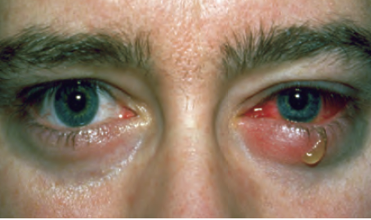
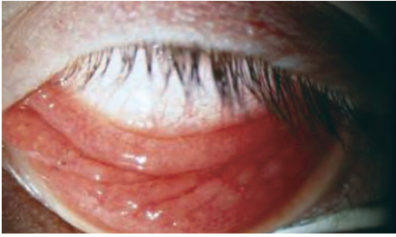
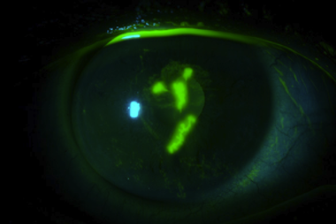
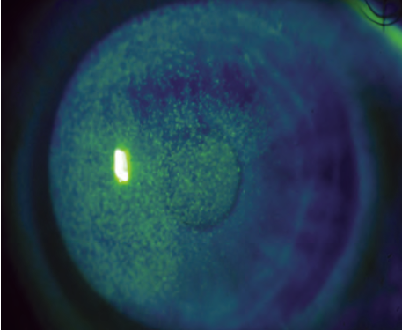
36YOF presents to you with 1 day history of LE pain, photophobia and decreased vision (6/12 w/ PH). She is a contact lens wearer.
Describe what you see?
What are your ddx at this stage?
What other tests would you do?
What is your most likely diagnosis now?
What is your management?
Patient is currently in second trimester. Any changes to mx?
Are any medications contraindicated? Why?
What are some possible sequalae if left untreated?
Notes:
Common sx: Redness, serous discharge, photophobia, FBS, blurry vision, pain (severe/mild/absent), unilateral
Signs: IOP may be elevated (esp if iritis), reduced corneal sensation (damage to CNVi), preauricular lymphadenopathy, grouped vesicular or vesiculopustular eruption of eyelid and adjacent skin
Adeno Vs. HSV – HSV rarely forms pseudomembranes
DDx: Non-HSV viral keratitis (Adeno, VZV, EBV, CMV), Acanthamoeba keratitis, Fungal keratitis, Bacterial keratitis, Infected corneal ulcer, Neurotrophic keratitis, Exposure keratopathy, Basement membrane dystrophy, Abrasion
More than one ocular site may be involved; breakdown of the Minnesota data suggests that approximately 72% of ocular HSV disease involves the corneal epithelium; 41%, the lid or conjunctiva; 12%, the corneal stroma; and 9%, the iris and associated uveal tract [Pavan-Langston D. Part one: the research perspective. Advances in the management of ocular herpetic disease. Candeo Clinical/Science Communications. 2011;1-9.]
A retrospective study at the Cullen Eye Institute found recurrence rates in children to be similar to those in adults, although there was a higher risk of bilateral involvement among children
Studies suggest that 10% of patients with epithelial keratitis will go on to experience stromal disease within a year, and patients with a history of multiple recurrences remain at increased risk for future recurrences. [The Herpetic Eye Disease Study Group. A controlled trial of oral acyclovir for the prevention of stromal keratitis or iritis in patients with herpes simplex virus epithelial keratitis. The Epithelial Keratitis Trial. Arch Ophthalmol. 1997;115:703-12.]
Pregnancy category B3 = Insufficient human trials, animal studies showed increased occurrence of fetal damage, significance of which is considered uncertain in humans.
Lactation = limited hman data shows it does NOT pass into breast milk

Slide 7
36YOF presents to you with 1 day history of LE pain, photophobia and decreased vision (6/12 w/ PH). She is a contact lens wearer.
Describe what you see? Conj injection, serous discharge, follicular conjunctivitis
What are your ddx at this stage? HSV/Adeno/VZV/EBV/CMV keratitis, acanthamoeba, fungal keratitis, bacterial keratitis, conjunctivitis
What other tests would you do? NaFl assessment, corneal sensitivity, IOP
What is your most likely diagnosis now? HSV epithelial keratitis
What is your management? Acyclovir 3% ointment 5x/day until dendrites resolve + cold compress + ATs + infection control (do not share shit) + disinfect consulting room
Patient is currently in second trimester. Any changes to mx? Acyclovir is cat B3 i.e. limited studies humans but no effect. Animals shows changes to foetus
Are any medications contraindicated? Why? Steroids. Convert dendritic lesions to geographic ulcers
What are some possible sequalae if left untreated? Stromal/endothelial keratitis → Stromal scarring, neovascularisation, ulceration, peforation
Notes:
Common sx: Redness, serous discharge, photophobia, FBS, blurry vision, pain (severe/mild/absent), unilateral
Signs: IOP may be elevated (esp if iritis), reduced corneal sensation (damage to CNVi), preauricular lymphadenopathy, grouped vesicular or vesiculopustular eruption of eyelid and adjacent skin
Adeno Vs. HSV – HSV rarely forms pseudomembranes
DDx: Non-HSV viral keratitis (Adeno, VZV, EBV, CMV), Acanthamoeba keratitis, Fungal keratitis, Bacterial keratitis, Infected corneal ulcer, Neurotrophic keratitis, Exposure keratopathy, Basement membrane dystrophy, Abrasion
More than one ocular site may be involved; breakdown of the Minnesota data suggests that approximately 72% of ocular HSV disease involves the corneal epithelium; 41%, the lid or conjunctiva; 12%, the corneal stroma; and 9%, the iris and associated uveal tract [Pavan-Langston D. Part one: the research perspective. Advances in the management of ocular herpetic disease. Candeo Clinical/Science Communications. 2011;1-9.]
A retrospective study at the Cullen Eye Institute found recurrence rates in children to be similar to those in adults, although there was a higher risk of bilateral involvement among children
Studies suggest that 10% of patients with epithelial keratitis will go on to experience stromal disease within a year, and patients with a history of multiple recurrences remain at increased risk for future recurrences. [The Herpetic Eye Disease Study Group. A controlled trial of oral acyclovir for the prevention of stromal keratitis or iritis in patients with herpes simplex virus epithelial keratitis. The Epithelial Keratitis Trial. Arch Ophthalmol. 1997;115:703-12.]
Pregnancy category B3 = Insufficient human trials, animal studies showed increased occurrence of fetal damage, significance of which is considered uncertain in humans.
Lactation = limited hman data shows it does NOT pass into breast milk
Most cases of HSV epithelial keratitis resolve spontaneously within 3 weeks, however American Academy of ophthalmology recommends treating to prevent recurrence and progression to stromal or endothelial keratitis
Steroids can hasten progression of dendritic to geographic [Wilhelmus KR, Coster DJ, Donovan HC, et al. Prognosis indicators of herpetic keratitis. Analysis of a five-year observation period after corneal ulceration. Arch Ophthalmol 1981;99:1578-82]

Slide 8
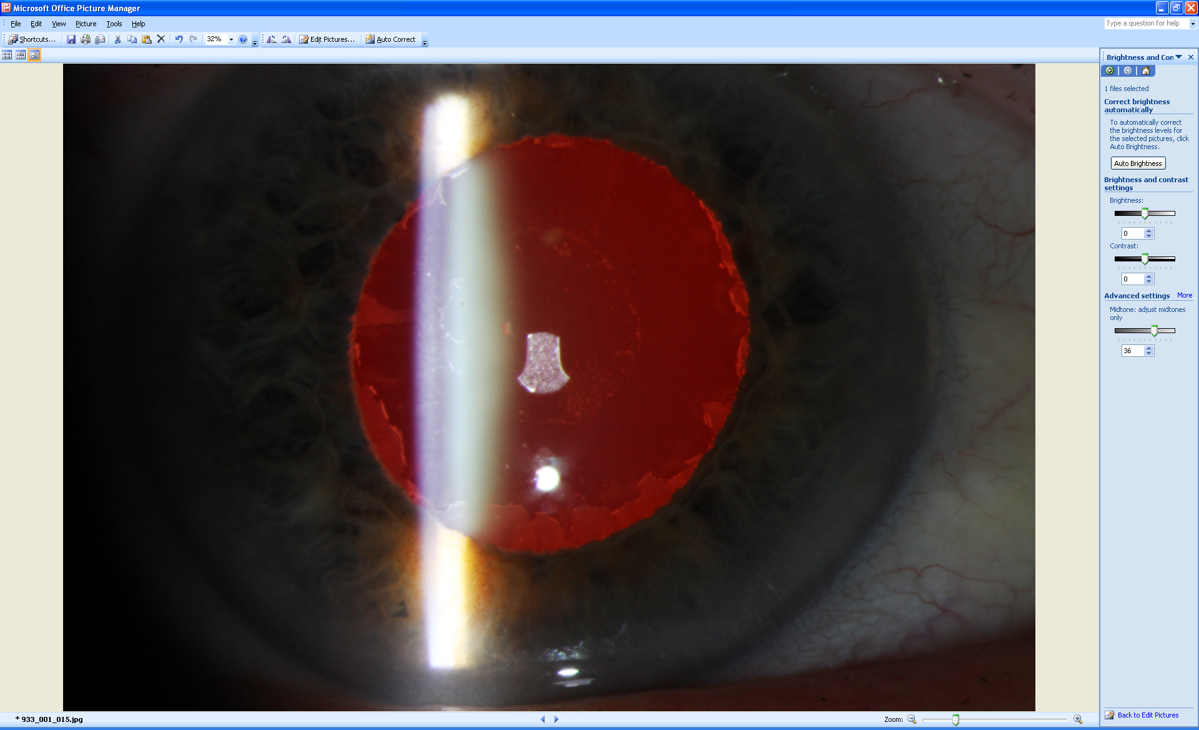
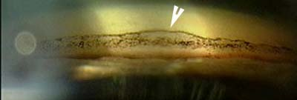
76YOF presents for routine eye examination as her sister was recently diagnosed with glaucoma
This is her left eye. Describe what you see in the anterior eye photo
What is the second image? What do you see?
What is your ddx and most likely dx?
What is the pathophysiology of your dx?
What other signs would you expect to see?
What is risk of developing glaucoma?
What is rate of visual field progression?

Slide 9
76YOF presents for routine eye examination as her sister was recently diagnosed with glaucoma
This is her left eye. Describe what you see in the anterior eye photo Pseudoexfoliative material on lens (central white material, clear zone + granular peripheral). No TID (typically pupil margin
What is the second image? What do you see? Gonioscopy of inferior angle. Open to CBB. Sampaolesi’s line (white arrow)
What is your most likely dx? PXF
What is the pathophysiology of your dx? LOXL1 gene mutation → overproduction of elastin = major component of material. PXF material (amyloid) clogs TM → reduced aqueous outflow → IOP elevation → Glaucoma
What other signs would you expect to see? Corneal guttate, peripupillary atrophy, poor pupil dilation, phacodonesis, frosted zonular fibres
What is risk of developing glaucoma? Lifetime risk is 35-50% - Risk of PXG with PXF is 1% per year i.e. 5% at 5 years and 15% at 15 years
What is rate of visual field progression? -3.13dB [EMGT]

Slide 10
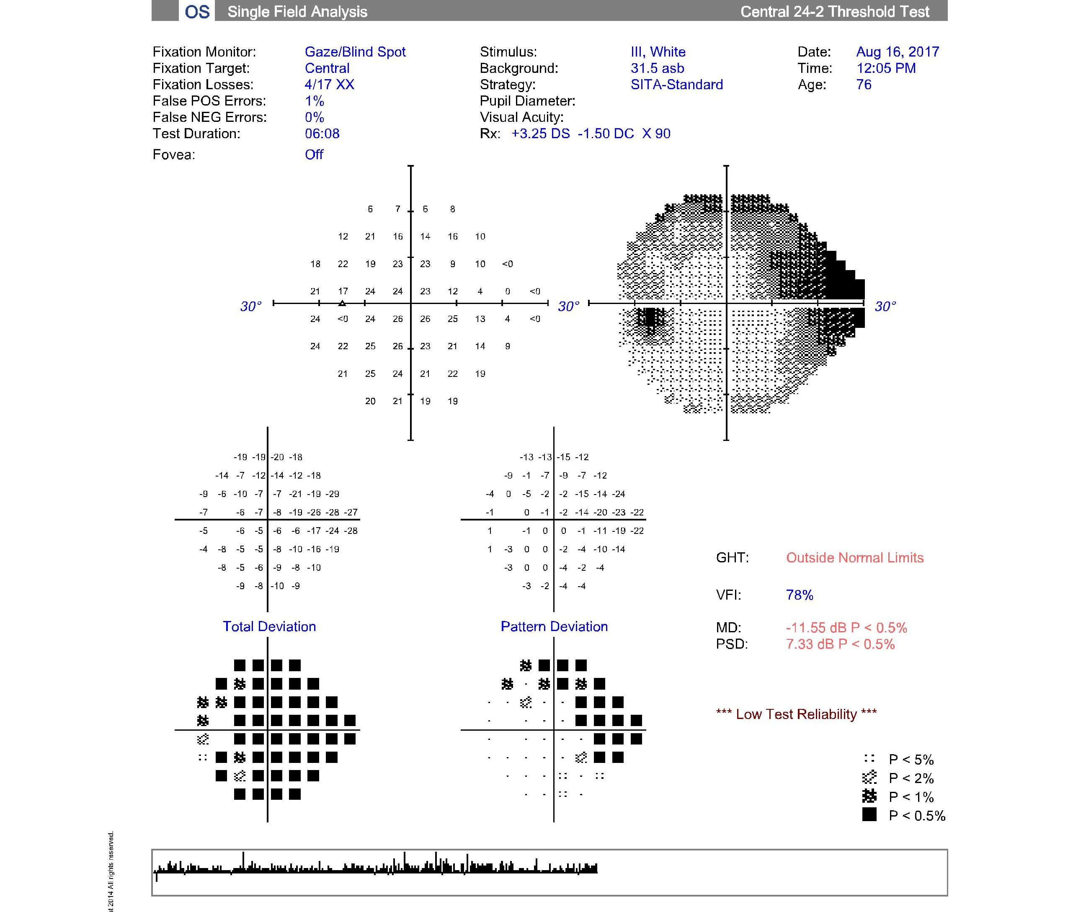
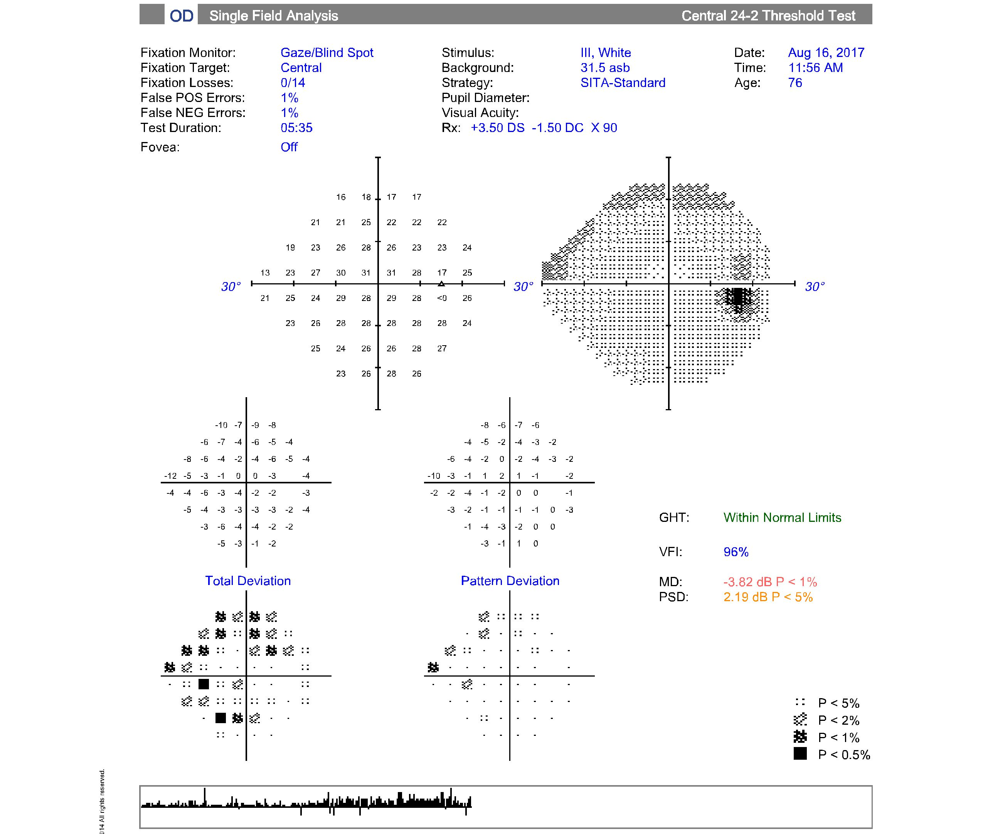
76YOF

Slide 11
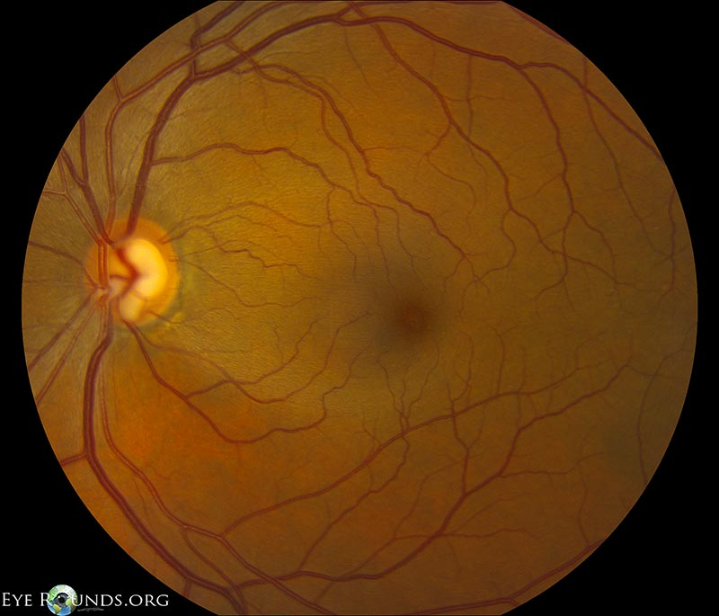
76YOF - ii
Describe the VF and your ddx?
Describe the left eye seen here
If the VF and this left eye were from the same patient what is your dx now?

Slide 12
76YOF - ii
Describe the VF and your ddx?
  OS dense super arcuate + nasal step
  OD early sup arcuate
    Neither obey V/H midline
  DDx: Glaucoma, optic neuritis, papilledema, congenital tilted discs,
Describe the left eye seen here
  Average size nerve, CDR 0.8/0.6 V/H
  NRR inferior notch, temporal thin
  Wide inferior RNFL wedge defect
  PPA-alpha
  No drance haem
If the VF and this left eye were from the same patient what is your dx now? Glaucoma – most likely NTG
Mod glaucoma OS (Mills MD = -11.55dB)
Early glaucoma OD (Mills MD = -3.82dB)

Slide 13
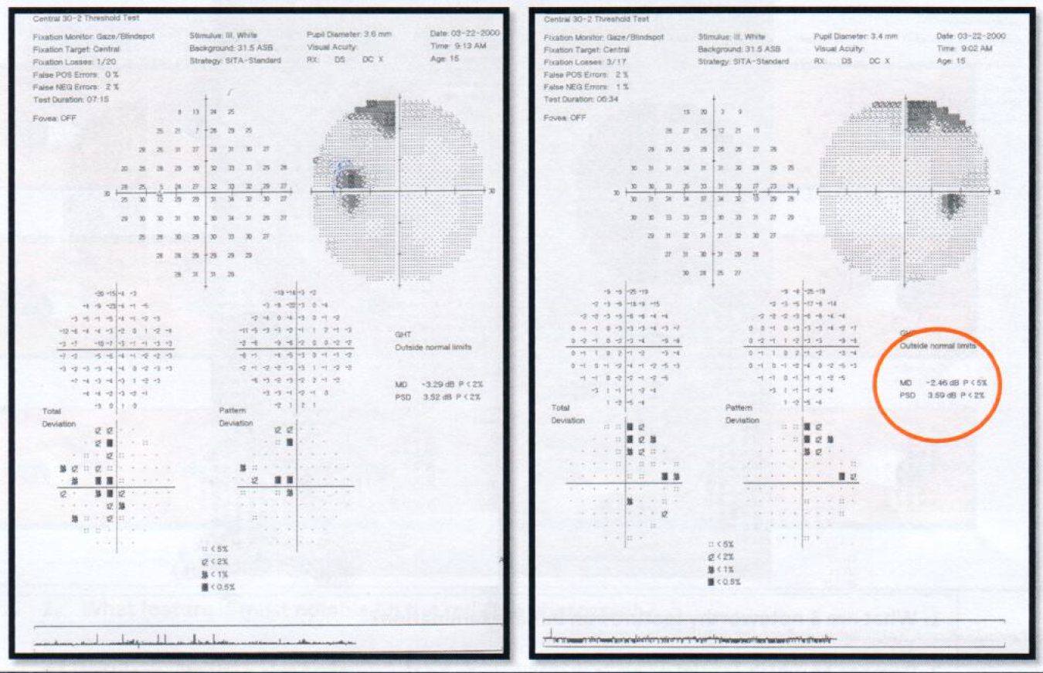
15YOF
Describe the VF and your ddx?
Incomplete bitemporal hemianopia on 30-2 neurological VF
DDx: Chiasmal lesion (pituitary adenoma),
Notes:
RE: pituitary adenoma from below → VF defect starts superiorly
Craniopharyngioma from above → VF starts inferiorly

Slide 14
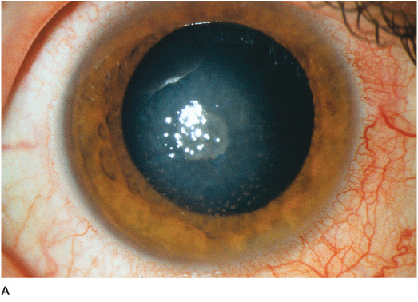
Case 1: A 30 year-old female presents with a painless red right eye (shown below) with blurry vision (gradually over 1 week). BCVA: R 6/15 L 6/6. There have been no previously reported episodes. You notice some round blister-like lesions along her eyelid. The pupil is pharmacologically dilated in this photo (pupil responses normal prior to mydriacyl instillation).

Slide 15
Case 1
Describe what you see
What other tests would you do to confirm your diagnosis?
DDx?
Diagnosis?
Management?
Prognosis?
Notes:
Corneal sensitivity, check for preauricular lymphadenopathy, check for epithelial involvement (fluorescein), DFE
Why do you think it is painless?

Slide 16
Case 1
Describe what you see:
  Central disciform region of stromal oedema with underlying Descemet’s folds
  Granulomatous keratic precipitates underlying the stromal haze, in the inferior cornea
  Conjunctival injection
Other tests:
  Corneal sensitivity, check for preauricular lymphadenopathy, check for epithelial involvement (fluorescein), DFE (to rule out posterior eye involvement e.g. PORN)
DDx:
  AAU, HSV stromal keratitis, HSV endotheliitis, Acanthamoeba keratitis, fungal keratitis
Notes:
HSV stromal keratitis is associated with the highest and most severe morbidity of any ocular herpetic disease. Although this condition frequently follows previous HSV epithelial keratitis, it can be the initial presentation of ocular herpetic disease. The vast majority of cases are an immune stromal keratitis (ISK), which involves the antibody-complement cascade against retained viral antigens in the stroma. The quintessential manifestation is a mid-to-deep stromal infiltrate that is associated with an intact epithelium and minimal stromal necrosis and thinning. However, the initial presentation may be multiple areas of diffuse stromal haze (such as that in our case presentation) that is often dismissed by clinicians as "chronic stromal scarring." Chronic ISK may be associated with progressive mid-to-deep stromal vascularization, with or without associated lipid keratopathy and permanent corneal scarring (Figure 4). Necrotizing interstitial keratitis (NIK) is a rare manifestation that is believed to be associated with live viral proliferation within the stroma. It presents with an epithelial defect, dense stromal infiltration, and progressive necrosis that often results in corneal perforation.

Slide 17
Diagnosis:
  HSV Stromal (Disciform or Interstitial) Keratitis
Management:
  Pred Forte 1% QID RE
  Topical Aciclovir 3% ointment 5 times a day RE
  Review daily until improvement in signs → taper steroid over no less than 4 weeks (Kanski)
  Following resolution, recommend oral acyclovir 400mg BID (HEDS, 1994) – long-term (important to check for any renal disease, and periodically check this considering the long-term treatment)
  Risk factors in recurrence: history of HSV stromal keratitis, greater number of previous HSV episodes (of any type)
Notes:
Rate of recurrence of ocular HSV disease reduced by 50% - recommend oral acyclovir 400mg BID in patients who have had history of (but not current) HSV stromal keratitis, especially younger patients
The benefit of prophylactic/preventative therapy is only sustained for as long as the therapy is sustained

Slide 18
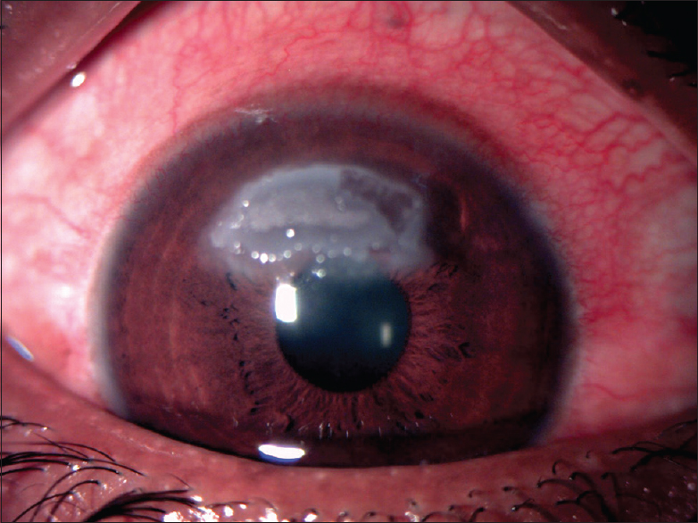
Case 2: 8 year-old boy presents with bilateral itchy red eyes, which have progressively gotten worse since the start of September. He reports getting a yellowy-white discharge from both eyes.

Slide 19
Case 2
Describe the lesion and its pathophysiology
What other signs could you potentially see in this condition?
DDx?
Management?
Prognosis?

Slide 20
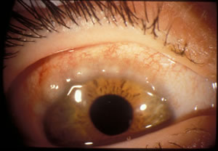
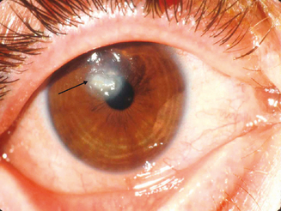
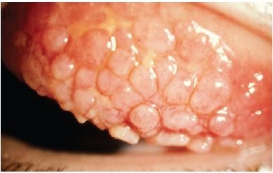
Identify these signs
Notes:
Main symptom: intense skin rashes
Other symptoms: photophobia, burning, tearing, mild ptosis, and thick, yellow mucoid discharge
VKC
1. Palpebral - marked cobblestone papillae on the superior tarsal conjunctiva, with minimal involvement of lower lid.
2. Limbal - broad, thickened, gelatinous opacification of the superior limbus. Horner-Trantas Dots (while nodules composed of eosinophils and epithelial debris located at the limbus) are characteristic of limbal VKC. Px with VKC have elevated levels of histamine and other cytokines and immunologic molecules in the tear film. Common in Black and Asians . Superior corneal ‘shield’ ulcer (well-delineated, sterile, gray-white infiltrate)
3. Mixed
DDx
Acute Allergic Conjunctivitis (Seasonal/Perennial)
Chronic Atopic Keratoconjunctivitis
Late teens - fifth decade, slight male predominance
20 - 40% of Px’s will have atopic dermatitis
Papillary hypertrophy of the lower tarsal conjunctiva is the most common sign
Cobblestone papillae on the superior tarsal conjunctiva may also occur
Bacterial Conjunctivitis
Allergic Dermatoconjunctivitis
GPC
Work up
Hx of recurrences?
Rule out AKC- very similar but with hx of atopy (and adults c.f. VKC)
Grade shield ulcer (Cameron grading scale)
Grade 1: epithelial defect + transparent base
Grade 2: Translucent base +/- opaque deposits
Grade 3: Opaque elevated plaque (delays re-epithelialization, because it is cytotoxic - releases histamine, need to debride this)
Mx
Supportive therapy (mild-itchiness)
Tx is based on the severity and chronicity of disease
Cold compresses (four times a day)- Bilkhu et al 2014- CC along with lubricants or anti allergic meds was sup
Lid hygiene (Theratears Sterilid Foam once a day at night)
Preservative-free artificial tears for symptomatic relief (Theratears minims when needed)
Avoid eye rubbing - can be cause of keratoconus and also exacerbates condition
Non-pharmacological tx

Slide 21
Case 2
Shield ulcer in VKC:
  Mechanical hypothesis: corneal surface abraded by giant papillae on the upper tarsal conjunctiva
  Toxin hypothesis: inflammatory mediators secreted from the eosinophils induce corneal epithelial damage
Other signs:
  Papillary hypertrophy esp. GPC, Horner Trantas dots (collections of eosinophils) at the limbus
DDx:
  Seasonal/perennial allergic conjunctivitis → expect watery discharge
  Bacterial conjunctivitis → more acute onset, one eye first then the other, not itchy
  PUK, SLK
  Microbial keratitis e.g. bacterial, HSV, fungal (due to presence of ulcer)
  Neurotrophic keratopathy (e.g. from drug/anaesthetic toxicity)
Notes:
Dense plaque formed over the ulcer by deposition of toxic eosinophilic granule major basic protein (secreted by eosinophils) which is cytotoxic and delays re-epithelialisation
Conjunctival scrapings or tear cytology can be useful, revealing increased leukocytes in the conjunctiva, particularly eosinophils

Slide 22
Case 2
Management:
  Palliative mx: cool compresses QID, allergan avoidance
  Topical antihistamine + mast cell stabiliser combination drug: Ketotifen 0.025% BID OU
  Epithelial debridement + AMT (Reddy et al): for stage 2-3 ulcers (Cameron grading scale)
  Topical chloramphenicol ointment 1% QID OU
  High pulsed therapy: Topical Pred Forte 1% - 1 drop every 2 hours for 4-7 days, then QID OU for 4-7 days (in total no more than 2 weeks)
  Review in 1-3 days due to shield ulcer present
  Prophylaxis: start sodium cromoglycate 2% QID OU 4-6 weeks before allergy season, oral antihistamines
Prognosis:
  VKC is benign and a self-limiting disease that may resolve with age or spontaneously at puberty
  Takes 21 days for shield ulcer to resolve (Reddy et al)
  12% of patients: symptoms may persist into adulthood in the form of Atopic Keratoconjunctivitis (AKC)
Notes:
Cycloplegic? Purpose?

Slide 23
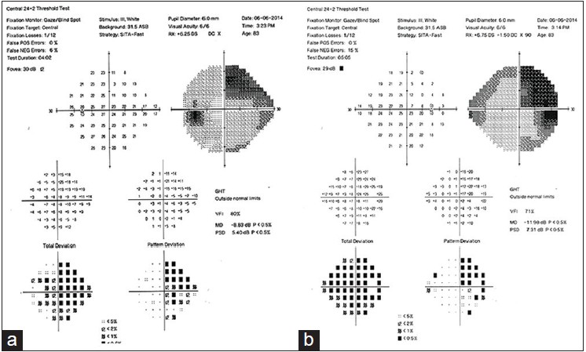
Case 3: 52 year-old male presents for an ocular assessment. He reports having difficulty seeing some traffic signs. History includes a car accident 3 years ago where he hit his head. During the examination, he reported seeing a red flower on the consult room wall. Pupils were equal, round and reactive, with no RAPD. Fundus assessment showed no abnormalities.

Slide 24
Case 3
Describe the defect
DDx?
Diagnosis?
Incomplete R homonymous hemianopia
L temporal lobe damage
L optic tract lesion – expect RAPD
Damage to the left calcarine sulcus – expect to be more congruous
Notes:
Formed hallucinations and no RAPD → suggestive of temporal lobe lesion

Slide 25
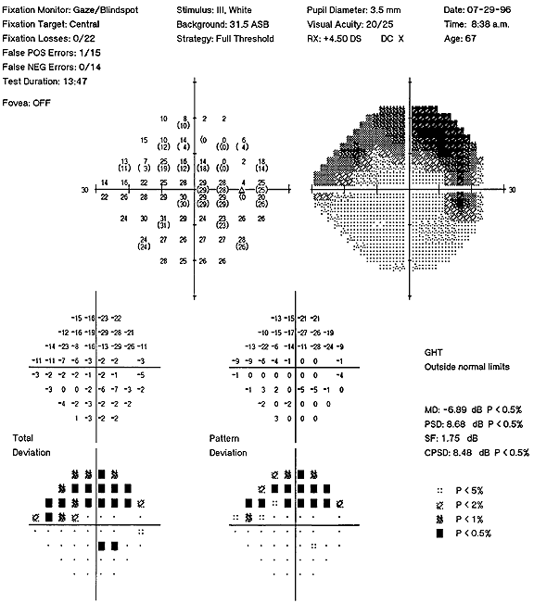
Case 4: 67 year-old hypertensive female
Describe this VF print-out
List conditions that can cause this type of VF defect
  Glaucoma (any type) with inferior wedge defect
  Optic disc drusen
  Inferior BRVO/BRAO
  AION
  Optic neuritis
  Inferior temporal chorioretinal scar
  Tilted disc syndrome

Slide 26
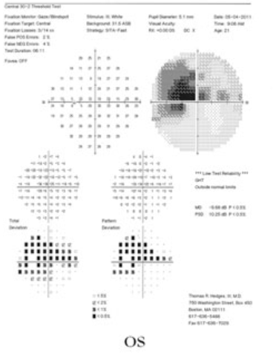
Case 5
Describe the defect
Potential causes?
  LHON
  Autosomal dominant optic atrophy (ADOA)
  Toxic/nutritional optic neuropathies
  Optic neuritis
  NAION/AAION
  NTG
  Macular disease
  Cilioretinal artery occlusion

Slide 27
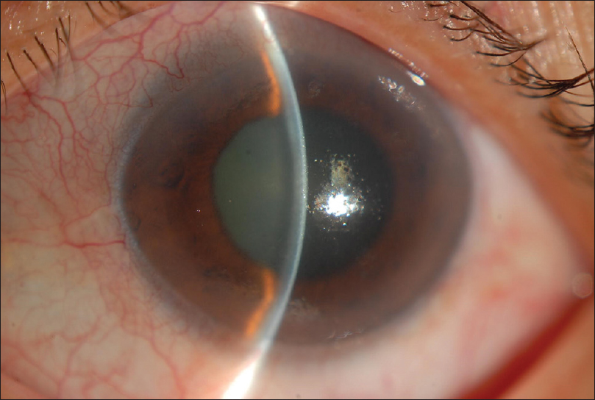
Case 6: 50 year-old female presents with a left-sided headache and ocular pain with blurry vision in OS, which began last night. Pupils showed a mid-dilated and sluggish left pupil, normal pupil responses in OD.

Slide 28
Case 6
Describe what you see
  Moderate conjunctival injection
  Shallow anterior chamber on VH
  Mid-dilated pupil
  Cornea oedema
DDx?
  Acute angle closure attack – shallow AC, unilateral, pain and blurry vision
  Posner Schlossman – also markedly high IOP (40-60mm Hg) and mild AC reaction, but usually minimal conjunctival injection, young to middle-aged, may have few fine KPs
  Pigment dispersion syndrome/pigmentary glaucoma – expect other associated signs e.g. pigment in AC, Krukenberg spindle, mid-peripheral radial TIDs
  Inflammatory OAG – can have acute IOP increase but with an open angle, greater anterior chamber reaction expected
  Anterior uveitis – sarcoidosis, HSV, toxoplasmosis; can cause PAS or trabeculitis → elevated IOP
  Fuch’s endothelial dystrophy – presence of corneal haze, pain due to rupture of epithelial bullae

Slide 29
Case 6
What is the pathophysiology of primary angle closure?
  Pupillary block: apposition of the lens and posterior iris at the pupil, leading to blockage of aqueous humour flow from posterior → anterior chamber, causing iris bombe (anterior bowing of the peripheral iris), obstructing the TM
  Angle crowding: due to abnormal iris configuration/anatomy e.g. plateau iris syndrome
What are some causes of secondary angle closure?
  PAS pulling the angle closed (e.g. inflammatory)
  Lens-induced (phacomorphic)
  Neovascular or fibrovascular membrane pulling the angle closed
  Medication-induced
What are the associations/risk factors for angle closure?
  Hyperopia, Asian, Female, family history of angle closure, phakic, older age
  Precipitating events: dim illumination, dilating drops, systemic medications with mydriatic side effects

Slide 30
Case 6
Management?
  Ring ophthalmologist immediately to discuss management with case, Diamox (oral acetazolamide 500mg) arrangement and co-ordinate transfer
  Allow approximately 2 min between each drop:
    Timolol 0.5%
    Apraclonidine 0.5%
    Brinzolamide 1%
  If the eye is red and inflamed: 4 drops of Pred Forte 1% in the first hour, then hourly after
  Discuss with ophthalmologist: Pilocarpine 2% when the IOP has been reduced to below 40mm Hg (only for mechanisms involving phakic pupillary block or angle crowding)
  Ophthalmologist to perform laser PI as soon as the cornea is clear and AC quiet (usually 1-5 days after the attack)

Slide 31
Case 6
What are the contraindications for diamox?
  Severe renal impairment (renal stones/renal failure), liver disease, sulphonamide allergy, respiratory/metabolic acidosis
What contraindications should you consider prior to use of topical IOP-lowering medications in the first aid of an acute angle closure attack?
  β-blocker: any reversible airway disease (e.g. asthma, COPD), cardiovascular disease (heart block, bradyarrhythmia, bradycardia <60bpm, cardiac failure), use of verapamil
  α2-agonist: children < 2 years (CNS effects), MAOIs
  CAIs: sulphonamide allergy, corneal graft, endothelial dystrophy
  Pilocarpine: retrolenticular causes of angle closure (e.g. malignant glaucoma), aphakic or pseudophakic pupillary block, secondary glaucomas with extensive outflow obstruction

Slide 32
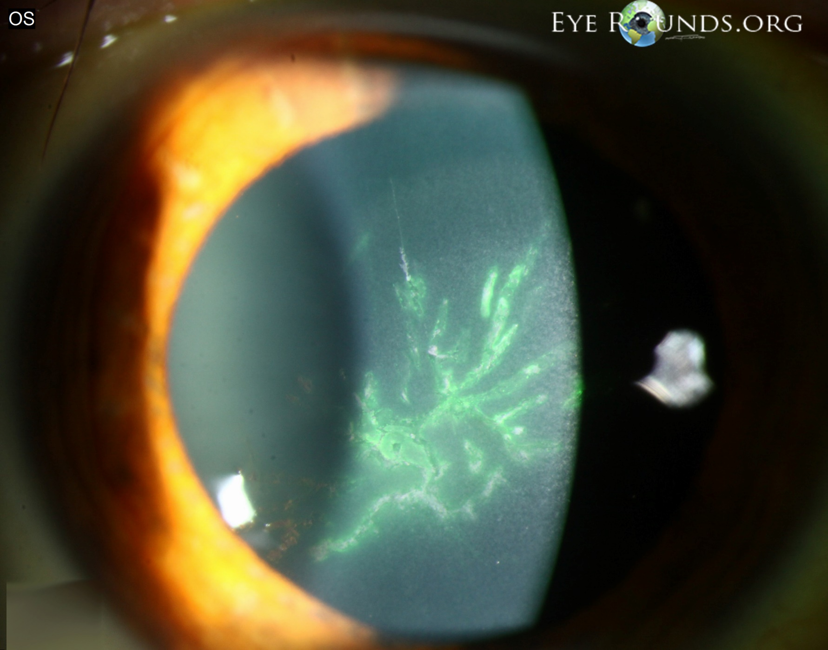
Case 7: 71YOM presents with a painful right eye with blurry vision and photophobia. He reports having a recent stabbing pain on his left face 3 days ago. You notice some rash-like skin lesions around the left eye and left side of the nose.
Notes:
Prodromal pain:
Approximately 70%–80% of patients with HZ describe prodromal pain in the dermatome where skin lesions subsequently appear. Prodromal pain may be constant or intermittent and frequent or sporadic, and it may or may not interfere with sleep.
Typically 2-3 days in duration

Slide 33

Case 7
Describe the lesion
  Central pseudo-dendritic corneal epithelial lesion, partially stains with fluorescein
DDx:
  HZO or VZV epithelial keratitis
  HSV epithelial keratitis: younger px, dendrites have terminal bulbs, stain better with fluorescein, whereas HZO has tapered ends of the pseudodendrites, with a stuck-on appearance (elevated), usually less painful compared to HZO, skins lesions can cross the vertical midline
  Healing corneal abrasion: usually involves history of trauma, usually exhibits negative staining, no skin involvement
  Recurrent corneal erosions: previous episodes, no skin involvement
  Acanthamoeba keratitis: can present with pseudodendrites, usually a CLs wearer, more chronic course, pain more severe and disproportionate to signs
  Contact dermatitis: no corneal involvement
Notes:
HZO corneal involvement:
Begins as epithelial keratitis (multiple, focal, swollen lesions that stain with rose bengal or fluorescein dye) as early as 1-2 days after initial skin rash → dendrites may form at 4-6 days
HZO dendrites appear as elevated plaques consisting of swollen epithelial cells, forming branching or medusa-like patterns with tapered ends
Stromal keratitis may present during the 2nd week of disease in 25-30% patients with HZO – nummular keratitis (multiple fine granular infiltrates in the anterior stroma, usually lying directly beneath pre-existing dendrites or areas of punctate epithelial keratitis), may be prolonged and recurrent

Slide 34
Case 7
Management?
  Refer for oral antiviral: famciclovir 250mg 3x a day for a minimum of 7 days
    Famciclovir and valaciclovir (1000mg 3x a day) preferred over aciclovir (800mg 5x a day) due to better bioavailability (hence less frequent dosing)
    Administering oral antiviral within 72 hours of onset of rash: speeds resolution of skin lesions, reduce viral shedding and decrease incidence of corneal involvement (dendritic and stromal keratitis) and anterior uveitis, and most importantly, may have a favourable effect on preventing post-herpetic neuralgia (Jackson et al., 1997)
  Skin lesions: palliative care with cool compresses, bathe lesions with saline to remove exudates
  Pain management: Paracetamol 1g every 4-6 hours (max 4g daily), refer to GP or pain specialist if significant pain
  Limit spread of disease:
    Warn about contact with children and pregnant women and immunocompromised
    Non-crusted lesions are active (when rash is < 1 week duration); after 1 week, rashes become crusted and inactive; cover non-crusted lesions with light non-adherent padding dressing
Prognosis?
  Post-herpetic neuralgia – varying degrees of constant or intermittent pain in the distribution of the affected dermatome that perists more than 3 months after the rash has healed
    Increased age (75% of >70 years) and prodromal symptoms associated with higher prevalence
    May last months to years
Notes:
http://www.aafp.org/afp/2002/1101/p1723.html#afp20021101p1723-b23
Famciclovir 500mg 3x a day approved dosage in US
Topical antiviral therapy lacks efficacy in patients with HZ and is not recommended.
The effect of treating herpes zoster with oral acyclovir in preventing postherpetic neuralgia. A meta-analysis (Jackson et al., 1997): Treatment of herpes zoster with 800 mg/d of oral acyclovir within 72 hours of rash onset may reduce the incidence of residual pain at 6 months by 46% in immunocompetent adults.

Slide 35
Case 8: 65 year-old Japanese female presents for routine eye exam.
Ocular history:
  LEE 2 years ago – was advised to return for VF but never returned
  (-) trauma, surgery
  Family history unknown
Medical history: high blood pressure (taking metoprolol – a systemic β-blocker)
Exam results:
  Rx/BCVA: OD -2.00DS 6/6 OS -1.75DS 6/6
  IOP (applanation): OD 19mm Hg OS 18mm Hg
  Motilities: no abnormalities
  Pupils: PERRL, no RAPD
  Anterior eye: G1+ NS OU

Slide 36
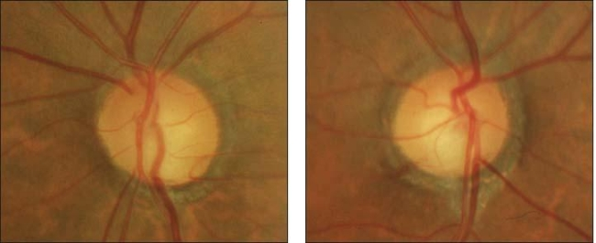
Case 8: Describe the optic nerve appearance (assume average sized nerve)
Inferior NRR thinning (does not follow ISNT)
Inferotemporal drance haemorrhage at 8 o’clock
β-PPA 360º
C/D 0.6/0.65
Distinct margins
No optic disc pallor
(Not in this picture but should also talk about RNFL reflectivity, size of ONH)

Slide 37
Case 8: Describe the optic nerve appearance (assume average sized nerve)
Inferior NRR thinning (does not follow ISNT)
Sloped superiorly
C/D: 0.5/0.65
Distinct margins
β-PPA almost 360º, more distinct inferiorly

Slide 38
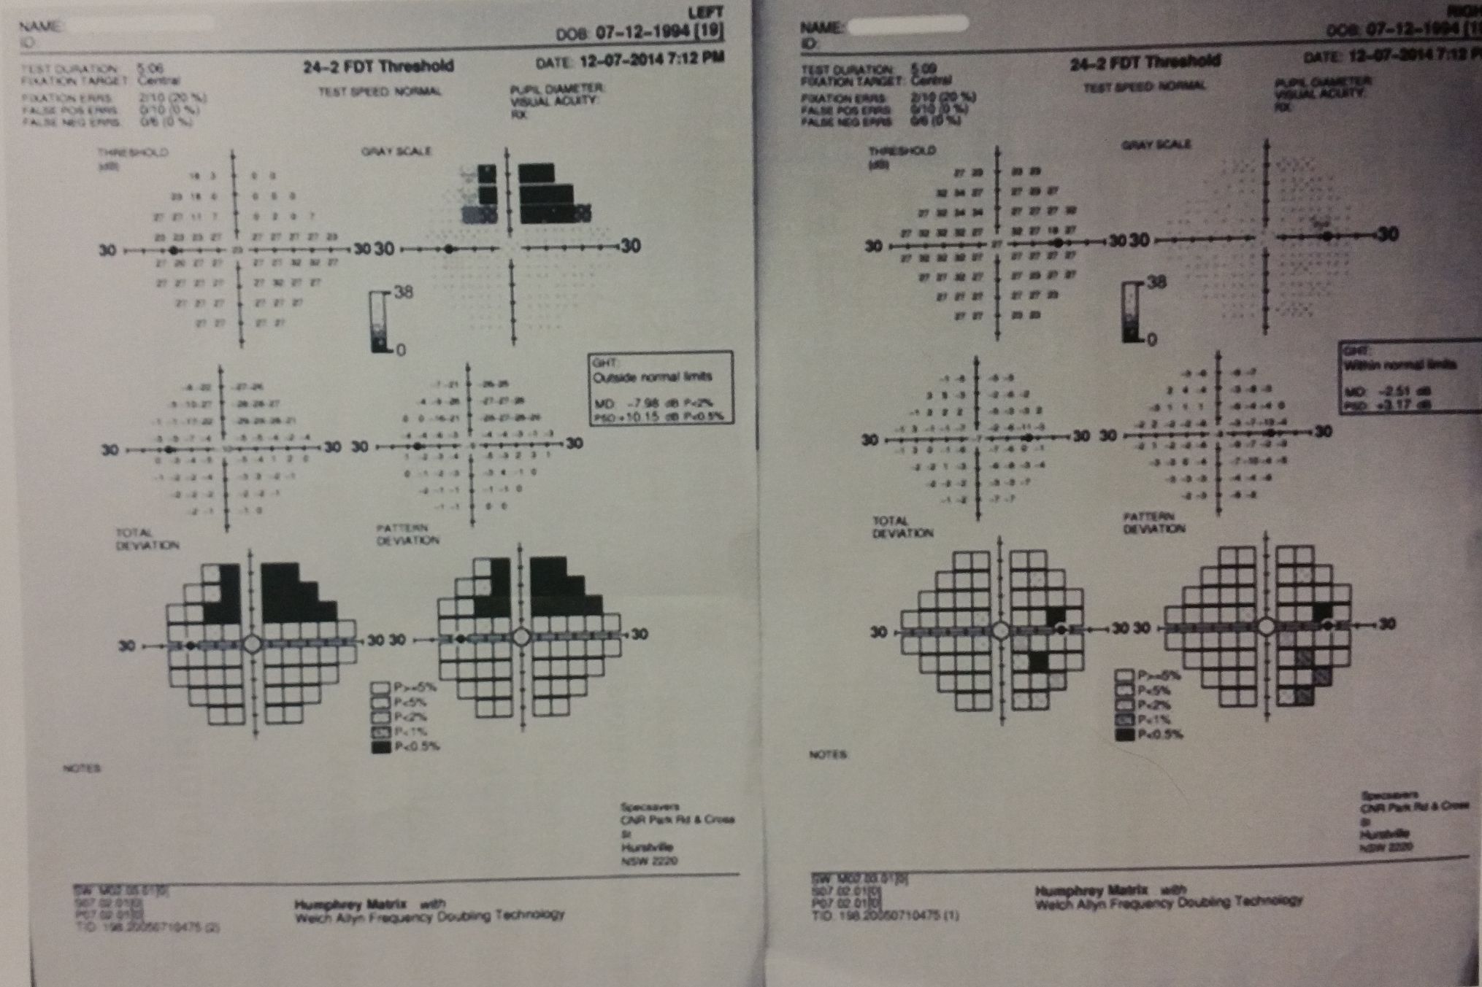
Case 8
Describe the VF print-out
  OD: Dense superior VF defect, GHT outside normal limits
  OS inferior temporal scattered (non-contiguous) points of depression, GHT within normal limits

Slide 39
Case 8
What other questions would you ask this patient?
  Do you suffer from migraines?
  Do you suffer from Raynaud’s phenomenon? (cold extremities)
  Do you suffer from sleep apnoea
  Previous haemodynamic crisis requiring blood transfusion
  History of steroid use: asthma or allergies
What other tests would you do?
  CCT → OD 505μm OS 515μm
  Gonioscopy → open to CBB 360º, 2+ pigment, regular pigmentation
  OCT of the RNFL → you don’t have access to an OCT
  Diurnal variation of IOP → OD 14-20mm Hg OS 13-19mm Hg

Slide 40
Case 8:
Differentials?
  Physiological large cupping
  Neurological field loss – primary optic atrophy (compressive lesion, retrobulbar optic neuritis, LHON, toxic and nutritional optic neuropathies, ONH drusen, traumatic optic atrophy), secondary optic atrophy (chronic papilloedema, ischaemic optic neuropathies, long-standing papillitis)
  Optic disc pit
  POAG – but IOP < 21-24mm Hg
  Pigmentary glaucoma (history of PDS but pigment receded)

Slide 41
Case 8
Diagnosis: Normal Tension Glaucoma
  Risk factors in this px: use of systemic beta-blocker, diurnal IOP consistently in the mid to high teens, evidence of structural loss correlating with VF loss, drance haemorrhage
  Diagnosis of exclusion
  CNTGS criteria:
    IOP ≤ 24mm Hg, median of 10 readings required to be ≤ 20mm Hg, no more than 1 reading of 23 or 24mm Hg
  Moorfields criteria for definition of NTG:
    A mean IOP off-treatment consistently ≤ 21mm Hg on diurnal testing, with no single measurement > 24mm Hg
    Open drainage angles on gonioscopy
    Absence of secondary causes for glaucomatous optic neuropathy
    Typical optic disc damage with glaucomatous cupping and loss of NRR correlating to VF defect (structure-function correlation)
    Progression of glaucomatous damage (controversial): CNTGS estimated the risk of progression in VF loss ranged from -0.2dB to -2dB per year

Slide 42
Case 8: VF defects are repeatable
Management?
  PGA:
    Highest efficacy of all topical IOP-lowering medications
    Target IOP reduction (30%, CNTGS) → slowed progression from 35% to 12%
  Avoid beta-blockers: due to concurrent use of systemic beta-blockers and potential cardiovascular and cross-over effects
  Difficult to treat, evidence supports lowering IOP as much as possible (AD’s notes)
Prognosis?
  CNTGS Natural history of NTG: -0.2dB to -2.0dB/year
  EMGTS: -0.36dB/year
  However, typically involve VF defects closer to fixation → monitor closely, consider 10-2

Slide 43
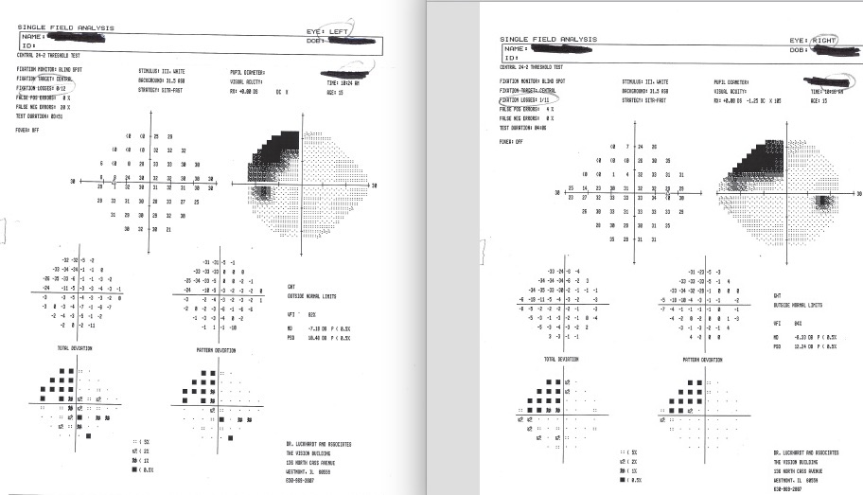
15YOM “I have trouble copying from the board at school”
Notes:
http://www.familyvisionandtherapy.com/your-visual-field/
Parietal lobe damage - trauma

Slide 44
83YOM
Notes:
PERRLA no RAPD
http://www.neurologyindia.com/article.asp?issn=0028-3886%3Byear=2014%3Bvolume=62%3Bissue=6%3Bspage=709%3Bepage=711%3Baulast=Matalia

Slide 45
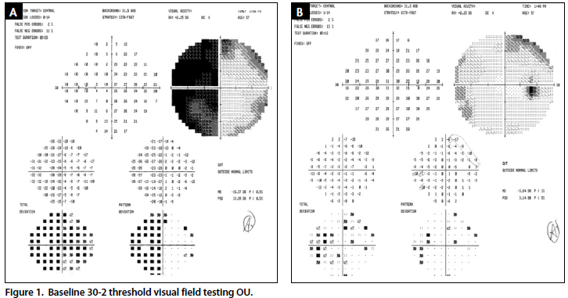
Notes:
http://eyetubeod.com/2014/03/asymmetrical-visual-field-defect
57-year-old white woman referred to our office for unexplained, gradual, and painless loss of vision OS. She reported a history of good, equal vision in both eyes and denied any other noticeable neurological or systemic symptoms other than that said she had “no hormones” and was receiving appropriate hormone replacement therapy.
Upon examination, her BCVA was 20/20 OD and 20/150 OS. Confrontation visual field testing revealed temporal constriction OS only with a correlating 1+ relative afferent pupillary defect OS. The clinical examination showed incipient cataracts, flat macula, and attached periphery OU. The optic nerve evaluation confirmed a normal and healthy appearance with overall symmetrical cupping of 0.3 OD and 0.25 OS and no signs of optic nerve edema or pallor OU.
Pituitary adenoma with internal haemorrhage = pituitary apoplexy

Slide 46
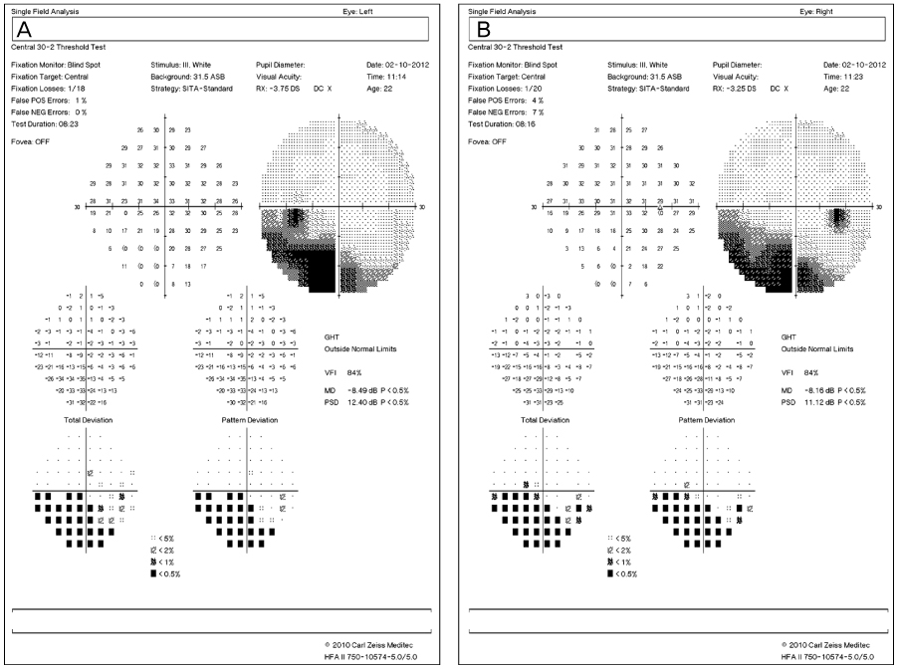
Notes:
Periventricular Leukomalacia affecting
Temporal pallor OU → supratemporal RNFL atrophy
https://synapse.koreamed.org/search.php?where=aview&id=10.3341/jkos.2013.54.6.987&code=0035JKOS&vmode=PUBREADER#!po=16.6667

Slide 47
